Slide 1





Welcome to Rainbows
23rd September 2026

Slide 2
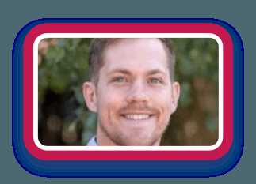
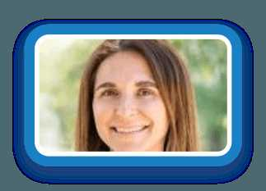
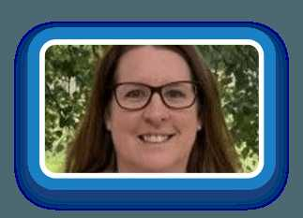
Rainbows Teaching Staff
Mr Williams
Rainbow 1
Mrs Butler
Mon, Tues, Thurs, Fri
Rainbow 2
Mrs Williams
Wednesday
Rainbow 2

Slide 3
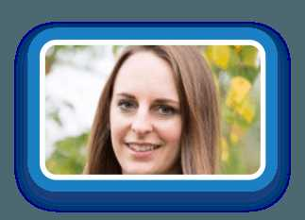
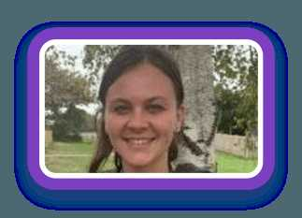
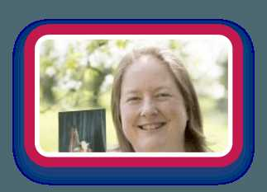
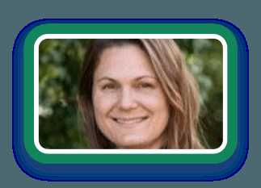
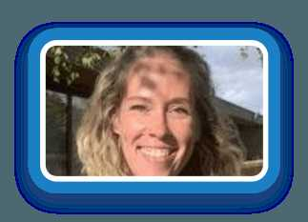
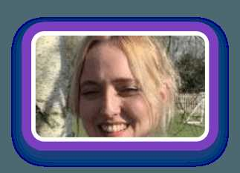

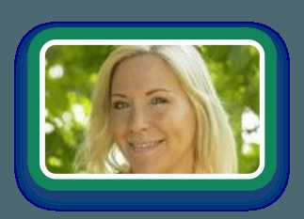
Rainbows Team
Ms Booth
Ms Douthwaite
Mrs Law
Mrs Suska
Class TA
Class TA
Music Teacher (Thursdays)
Forest School Teacher
Ms Smith
Ms Finch
Miss Ballman
Mrs Ladyman
LSA
LSA
LSA
LSA

Slide 4
What is the Early Years Foundation Stage?
The Early Years Foundation Stage (EYFS) is the stage of education for children from birth to the end of the Reception year.
It is based on the recognition that children learn best through play and active learning.
This is a very important stage as it helps your child get ready for school as well as preparing them for their future learning and successes.
From when your child is born up until the age of 5, their early years experience should be happy, active, exciting, fun and secure; and support their development, care and learning needs.

Slide 5




EYFS Guiding Principles
The EYFS has 4 guiding principles. These are:
A Unique Child
Positive Relationships
1
2
Enabling Environments
Learning and Development
3
4

Slide 6

7 Areas of Learning and Development
Your child will be learning skills, acquiring new knowledge and demonstrating their understanding through 7 areas of learning and development
Children should mostly develop the 3 prime areas first. These are:
As children grow, the prime areas will help them to develop skills in 4 specific areas. These are:
1. Communication and language
1. Literacy
2. Physical development
2. Mathematics
3. Personal, social and emotional development.
3. Understanding the world
4. Expressive arts and design.

Slide 7

Personal, Social and Emotional Development
become self-confident and independent, and take an interest in new things
understand and manage their own feelings, and be aware of the feelings of others
build positive friendships and play and work together with others
The children will be learning to:
manage their own basic hygiene and personal needs, including dressing and undressing independently
tell the difference between right and wrong

Slide 8

Communication and Language
talk confidently and clearly, and show awareness of their listener
enjoy listening to stories, songs and poems, showing good attention
listen carefully and follow instructions
The children will be learning to:
answer questions about stories, and ask questions of their own
build their vocabulary and express their ideas in full sentences

Slide 9

Physical Development
move confidently and safely
control their body, developing balance, strength and coordination
The children will be learning to:
handle equipment and small tools, such as scissors, paintbrushes and cutlery
strengthen their hands and fingers ready for writing

Slide 10

Literacy
hear and say sounds, and link them to the alphabet
read and write familiar words and sentences
The children will be learning to:
learn to use a pencil effectively
enjoy and talk about a wide range of stories, poems and rhymes, and understand what they have read

Slide 11

Mathematics
develop an understanding of maths through stories, songs, games and imaginative play
become comfortable with numbers and with ideas such as ‘heavier than’ or ‘bigger’
have a deep understanding of numbers to 10, and count beyond 20
The children will be learning to:
explore number patterns, such as doubles, odds and evens
be aware of shapes and space

Slide 12

Understanding the World
explore and find out about the world around them, asking questions about it
learn about the natural world, including plants, animals and the changing seasons
find out about past events in their lives and their families’ lives
The children will:
find out about different cultures, communities and beliefs
build with different materials, and know about everyday technology and what it is used for

Slide 13

Expressive Arts and Design
colours and shapes
making things
role play
The children will explore:
making music and singing songs
moving and dancing to music

Slide 14





How we teach in Rainbows
Twinkl Phonics Scheme
Daily, fun phonics lessons where children learn letter sounds, blend them to read and segment them to spell.
Master the Curriculum
(White Rose Maths)
Practical, hands-on maths using real objects, stories and games to build a deep understanding of number.
Helicopter Stories
Children make up their own stories, an adult writes them down word for word, and we act them out together.
Drawing Club
Children draw, talk and write about ideas inspired by a story, building imagination, vocabulary and early writing.
Funky Fingers
Playful activities that strengthen little fingers and hands, ready for holding a pencil and writing.

Slide 15





Our Sparkling Rules
Love
We are kind in words and actions
Honesty
We always tell the truth
Friendship
We try to be a good friend
Forgiveness
We forgive others
Compassion
We think about others
Respect
We look after everyone and everything in school

Slide 16

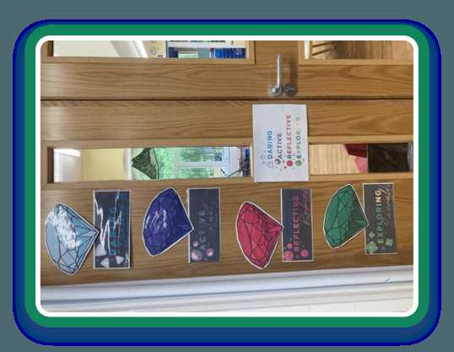
DARE Jewels – Learning Behaviours
‘You walked among the jewels that sparkled like fire.’ (Ezekiel 28:12-14)
Daring diamond
Having a go and trying new things, even when it feels tricky
Active Amethyst
Getting stuck in, staying focused and keeping going
Reflective Ruby
Thinking about what we have learned and how we can do even better
Exploring Emerald
Being curious, asking questions and finding things out

Slide 17
Monitoring Progress
Each of the 7 areas of learning has its own set of Early Learning Goals (ELGs), which determine what most children are expected to achieve by the end of Reception Class.
At the end of the year, we judge whether each child is ‘meeting expected levels’ or ‘emerging’ against each goal, and we share this with you in your child’s EYFS Profile.
We use Development Matters (the non-statutory curriculum guidance for the EYFS) to identify the developing knowledge, skills, understanding and attitudes that children will need if they are to achieve the Early Learning Goals by the end of the EYFS. These statements will be updated regularly throughout the year to show your child’s progress and development.

Slide 18
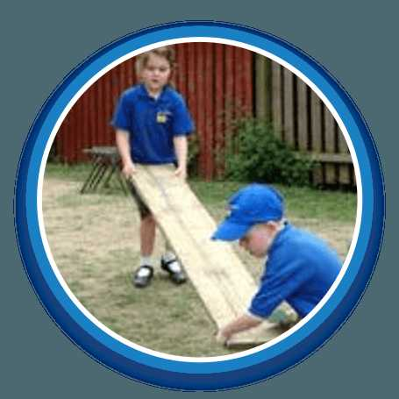
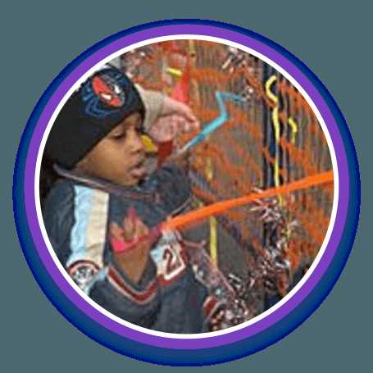
“Adults who help children to play are adults who help children to learn.”

Slide 19



How can you find out how your child is getting on?
It is important that parents and staff work together to help your child, so please do communicate with us.
We would love any ‘Wow’ moments at home to be uploaded onto Tapestry too!
We have a Parents Evening the week before half term and again in the second half of the Spring term.
We will also write end of year reports.

Slide 20


The first few weeks
We will get to know your children and they will get to know us and members of staff in the school. We will find out what the children already know and can do and use their interests to help inform our future planning.
We do the Reception Baseline Assessment which is a 1:1 activity with a member of staff. It is completed within the first six weeks of term, and you can ask us to share your child’s statement with you.
We also see what sounds they know and their segmenting and blending skills.

Slide 21




Uniform
Please ensure that your child’s name is in all items of clothing, including shoes and forest school clothes.
Please try and keep daily bags to just book bags, spare change of clothes in bags can stay in school until needed to go home.
Your child will be taking part in lots of interesting and sometimes messy experiences, so may come home dirty! It is all part of the fun! Having a spare change of clothes in school is very useful.
Keep an eye on the school website and look under Rainbows as this will update frequently with information on Topics, Wow days, Forest School and P.E. Days.

Slide 22
Class Days
Rainbow 1
Rainbow 2
Forest School
Wednesday afternoon
Forest School
Tuesday morning
PE
Tuesday and Friday
PE
Tuesday and Friday
Music
Thursday
Music
Thursday
Food Technology on alternating Thursdays
Rainbow 1 one week, Rainbow 2 the following week.

Slide 23


WOW Days
These normally happen on the first day of each term to start off our new topic.
They are used to create excitement and wonder for the children’s learning.
They might sometimes dress up or bring in items – we will update you via email and on the class page in good time before this happens though!

Slide 24


Snacks
Please bring a named box at the start of each week with 5 snacks for the week.
The children also have access to fruit throughout the day.
Please NO NUTS, we are a nut free school.

Slide 25
Reading Books
The class will be assessed on their level 2 sounds (SATPIN) and depending on their recognition and blending, they will be given a reading book from the school’s reading scheme. Please bring it to school every day in book bags.
You will be given a diary to record comments in, when you share/read a book with your child.
We will change books twice a week.

Slide 26
Example of our Day – Morning
8.40 am | Arrive, Continuous Provision (CP) activities
8.50 am | Register
8.55 am | Phonics & literacy
9.15 am | Snack
9.30 am | CP activities
10.30 am | Collective Worship
10.45 am | School break
11.00 am | Maths
11.15 am | CP activities
11.50 am | Get ready for lunch/ story
12.00 pm | Lunch & Break

Slide 27
Example of our Day – Afternoon
1.10 pm | Register
1.20 pm | Funky Fingers
1.40 pm | CP activities linked to a class input
2.30 pm | Tidy Up
2.40 pm | Story
3.10 pm | Home Time
EAD/UW/PSED class inputs during the week
EAD = Expressive Arts and Design, UW = Understanding the World, PSED = Personal, Social and Emotional Development

Slide 28


Topics
Autumn:
All About Me
Spring:
Amazing Animals
Summer:
Ticket to Ride
Wow Days at the start of each topic – look at our webpage!
Specialist Weeks before each half term.

Slide 29


Helpers
We would LOVE adult helpers to come in during the school day to help change books, read to children, play phonics and maths board games etc.
If you are able to help, please go to the school office where they will have the relevant form for you to fill in.

Slide 30

Thank you for coming.

