Slide 1
Welcome to
Rainbows
September 2025

Slide 2
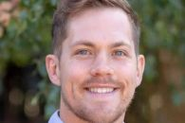
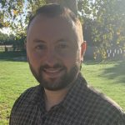
Rainbows Teaching Staff
Mr Williams Rainbow 1
Mr Kalamaj Rainbow 2

Slide 3
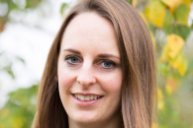
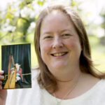
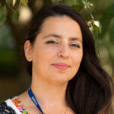
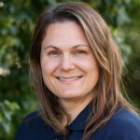
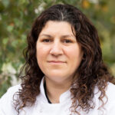
Rainbows Team
Ms Booth- Class TA
Mrs Tourit- Class TA
Mrs Law- Music teacher (Thursdays)
Mrs Martinez- Class TA
Mrs Souska- Forest School

Slide 4
What is the Early Years Foundation Stage?
The Early Years Foundation Stage (E.Y.F.S.) is the stage of education for children from birth to the end of the Reception year.
It is based on the recognition that children learn best through play and active learning.
This is a very important stage as it helps your child get ready for school as well as preparing them for their future learning and successes. From when your child is born up until the age of 5, their early years experience should be happy, active, exciting, fun and secure; and support their development, care and learning needs.

Slide 5
The E.Y.F.S. has 4 themes. These are:
1 A Unique Child
2 Positive Relationships
3 Enabling Environments
4 Learning and Development

Slide 6
Your child will be learning skills, acquiring new knowledge and demonstrating their understanding through 7 areas of learning and development
Children should mostly develop the 3 prime areas first. These are:
1. Communication and language
2. Physical development
3. Personal, social and emotional development.
As children grow, the prime areas will help them to develop skills in 4 specific areas. These are:
1. Literacy;
2. Mathematics;
3. Understanding the world; and
4. Expressive arts and design.

Slide 7
Personal, Social and Emotional Development
The children will be learning to:
Become self-confident;
Have awareness of their own feelings and feelings of others;
Take an interest in things;
Become independent;
Tell the difference between right and wrong.

Slide 8
Communication and Language
The children will be learning to:
Talk confidently and clearly;
Show awareness of listener
Enjoy listening to stories, songs and poems, showing good attention;
Follow instructions;
Answer questions about stories

Slide 9
Physical Development
The children will be learning to:
Move confidently;
Control their body;
Handle equipment.
Manage their own basic hygiene and personal needs including dressing and undressing independently

Slide 10
Literacy
Learn letter names and sounds, apply into reading words and then using sight words to help read sentences
Learn to use a pencil effectively.
Read and write familiar words using known phonics built into sentences;

Slide 11
Mathematics
The children will be learning to:
Become confident counting and subitising numbers to 10. Learn core mathematical vocabulary e.g. add, subtract. Learn and apply math facts e.g. number bonds.
Become comfortable with key mathematical fundamentals like measurement, shape, space.

Slide 12
Understanding the World
The children will:
Explore and find out about the world around them, asking questions about it;
Build with different materials, know about everyday technology and learn what it is used for;
Find out about past events in their lives and their families' lives;
Find out about different cultures and beliefs.

Slide 13
Expressive Arts and Design
The children will explore:
Colours and shapes;
Making things;
Role play;
Making music and singing songs

Slide 14
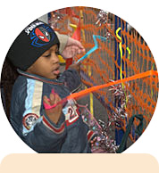
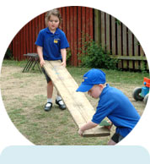
    “Adults who help children to play are adults who help children to learn.”

Slide 15
Two parents evening throughout the year
End of term report
Communication throughout the year
Monitoring and reporting attainment and progress

Slide 16
The first few weeks
We will get to know your children and they will get to know us and members of staff in the school. We will find out what the children already know and can do and use their interests to help inform our future planning.
We do the Reception Baseline Assessment which is a 1:1 activity with a member of staff.
We also see what sounds they know and their segmenting and blending skills.

Slide 17
Uniform
Please ensure that your child’s name is in all items of clothing, including shoes and forest school clothes.
Please try and keep daily bags to just book bags, spare change of clothes in bags can stay in school until needed to go home.
Your child will be taking part in lots of interesting and sometimes messy experiences, so may come home dirty! It is all part of the fun! Having a spare change of clothes in school is very useful.
Keep an eye on the school website and look under Rainbows as this will update frequently with information on Topics, Wow days, Forest School and P.E. Days.

Slide 18
Class Days
Forest school- Tuesday- Rainbow 2, Wednesday Rainbow 1
Friday- PE- children to wear school PE kit to school.
First Monday of the month- family church 9-9.30

Slide 19
Schemes of Work
Phonics- Twinkl Phonics
Maths- Master the Curriculum
Literacy- Literacy Shed
Oracy- Helicopter Stories, Poetry Basket, Drawing Club

Slide 20
WOW Days
These normally happen on the first day of each term to start off our new topic.
They are used to create excitement and wonder for the children’s learning.
They might sometimes dress up or bring in items- we will update you via email and on the class page in good time before this happens though!

Slide 21
Snacks
Please bring a named box at the start of each week with 5 snacks for the week.
The children also have access to fruit throughout the day.
Please NO NUTS, we are a nut free school.

Slide 22
Reading Books
The class will be assessed on their level 2 sounds (SATPIN) and depending on their recognition and blending, they will be given a reading book from the schools reading scheme. Please bring it to school every day in book bags.
You will be given a diary to record comments in, when you share/read a book with your child.
We will change books twice a week.
Reading raffle! Read 4 times or more each week for your child to be in with a chance of winning something from the weekly reading raffle on Fridays!

Slide 23
Example of our Day
08:40 Settling activity
09:00 Literacy
09.10 Snack
10.10- Phonics
10:30 Collective Worship
10:45 Playtime
11:05 Maths and Continuous Provision
12:00 Lunch
13:10 Registration and Fine Motor Skills
13:30 Understanding of the World and Continuous Provision
14:50 Story Time
15:10 Ready for Home

Slide 24
Topics
Autumn: All About Me
Spring: Amazing Animals
Summer: Ticket to Ride
Wow Days at the start of each topic-look at our webpage!
Specialist Weeks before each half term.

Slide 25
Helpers
We would LOVE adult helpers to come in during the school day to help change books, read to children, play phonics and maths board games etc.
If you are able to help; please go to the school office where they will have the relevant form for you to fill in

Slide 26
Thank you for coming!

