Slide 1

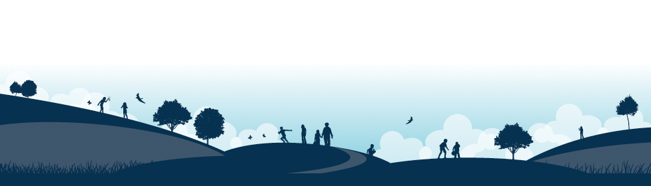
New Starters Information
‘We will sparkle like jewels under the guidance of Jesus his word being a lamp unto our feet and a light unto our path.’
Tuesday 24th June 2025

Slide 2
Welcome to Haddenham St Mary’s!
Our vision statement:
‘Excellence, care and fun and for all makes learning sparkle and shine leading to glittering opportunities.’
Our legacy:
For every child and every family to take away wonderful memories of their early years with us.

Slide 3
Today’s Meeting:
To help your child make the best possible start to school.
To show you the curriculum that your child will be covering in the reception class.
To understand how we teach in order to cover the requirements of the curriculum.
To identify the key ways in which you can help your child at home and in school.
Housekeeping information

Slide 4
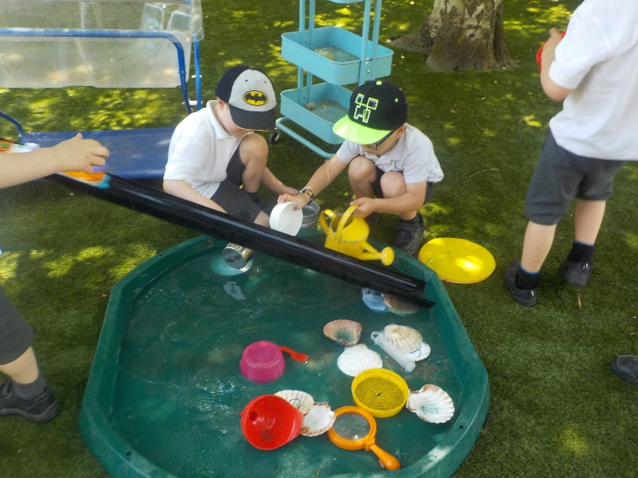
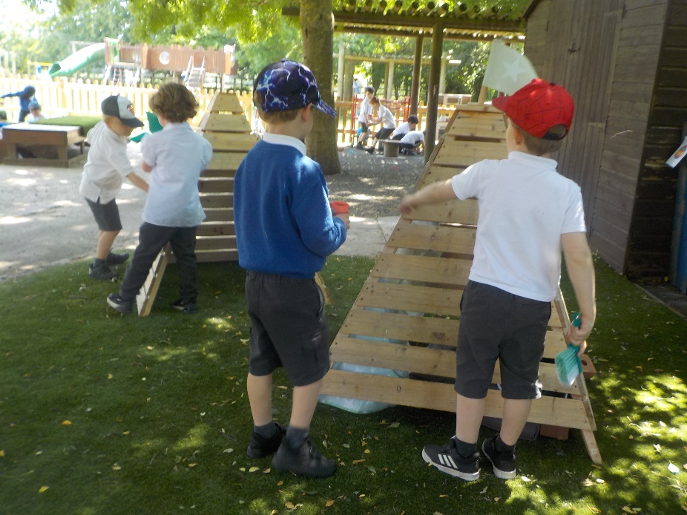
Play is at the heart of what we do

Slide 5
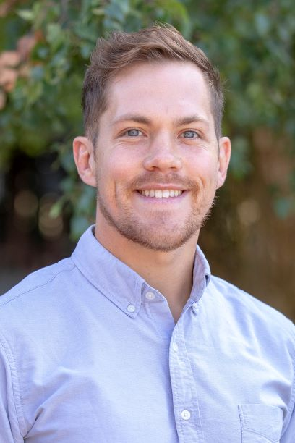

EYFS – Rainbows Teachers
Rainbow 1: Mr Williams (EYFS Coordinator)
Rainbow 2: Mr Kalamaj

Slide 6
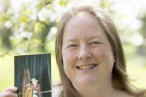
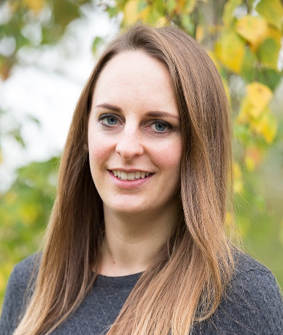
Other EYFS Staff
Mrs Law
(Music Teacher – Thursday)
Teaching Assistants:
Miss Booth

Slide 7
EYFS
The Early Years Foundation Stage (EYFS) is the stage of education for children from birth to the end of the Reception year.
Reception is the final year of the EYFS.
It is based on the recognition that children learn best through play and active learning.

Slide 8
EYFS – The New Curriculum
September 2024 EYFS Framework
Twinkl Phonics
Master the Curriculum- White Rose Maths
Helicopter Stories- communication, language and writing
Poetry Basket
Drawing Club
Funky fingers
NFER Baseline Assessment
Tapestry

Slide 9
A typical morning in Reception…
8.40 am Arrive, CP activities
8:50 am Register
8.55 am Phonics & literacy
9.15 am Snack
9.30 am CP activities
10.30 am Collective Worship
10.45 am School break
11.00 am Maths
11.15 am CP activities
11.50 am Get ready for lunch/ story
12.00 am Lunch & Break

Slide 10
A typical afternoon in Reception…
1.10pm Register
1.20pm Funky Fingers
1.40pm CP activities linked to a class input
2.30pm Tidy Up
2.40pm Story
3.10pm Home Time
EAD/UW/PSED class inputs during the week

Slide 11
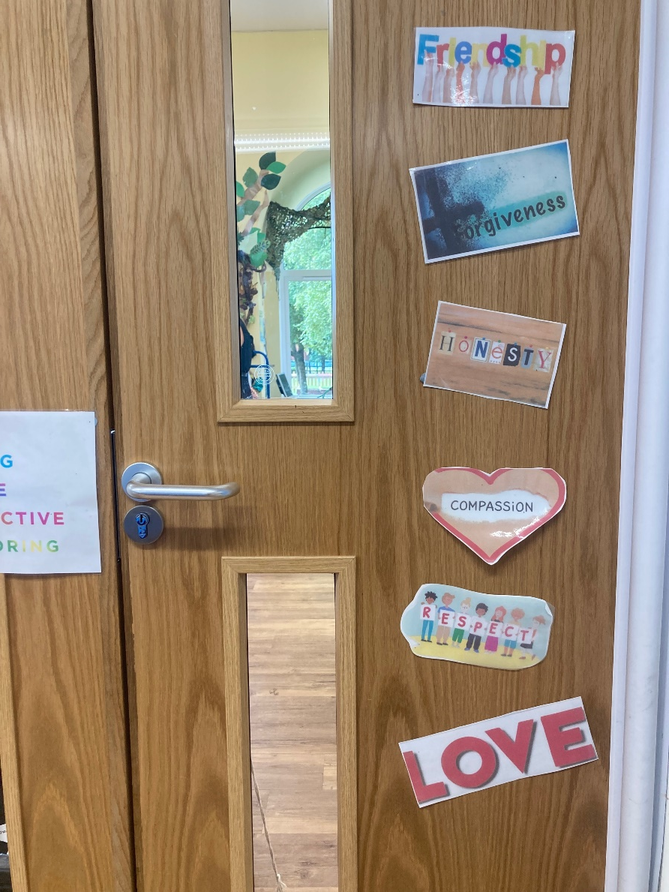
Christian Values
Respect
Honesty
Forgiveness
Love
Compassion
Friendship.

Slide 12
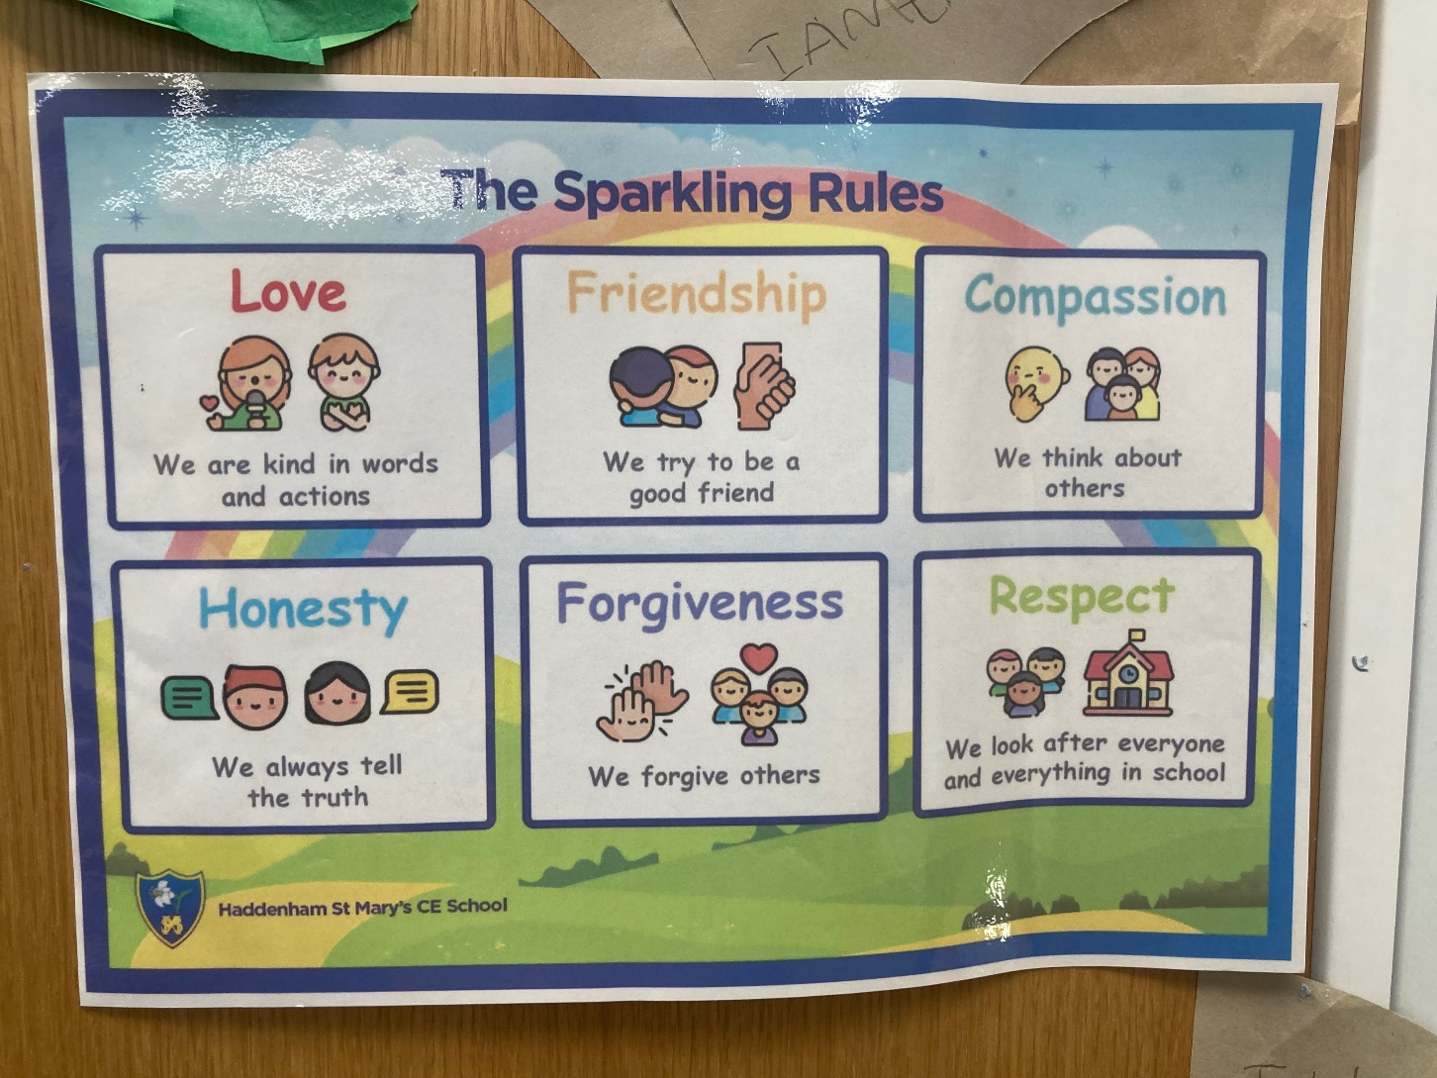
Sparkling Rules

Slide 13
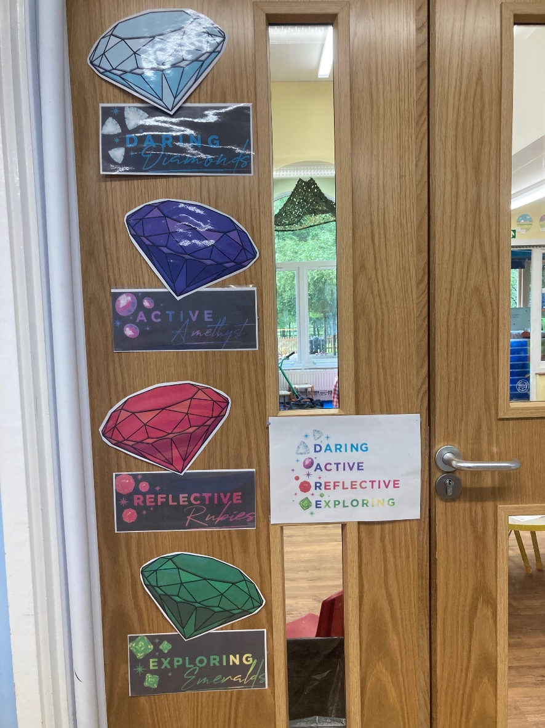
Learning Behaviours
‘You walked among the jewels that sparkled like fire.’ (Ezekiel 28:12-14)
Daring diamond
Active Amethyst
Reflective Ruby
Exploring Emerald

Slide 14

Zones of Regulation

Slide 15
Transition Arrangements
Tuesday 24th June: Stay and Play
May/June/July: Pre-school visits/calls
Tuesday 1st July: Class Transition Morning
Friday 5th – Wednesday 10th Part time sessions
September
Thursday 11th September Full time 8.35am- 3.10pm

Slide 16
What to bring to school
Coat
Wellies- a pair to leave in school please
Book bag- we will provide this during their first full week
Change of clothes in drawstring bag if possible (to remain in school)
Sunhat when appropriate
Snack (small tub with 5 snacks for the week please, no nuts)
Medication which needs to be in school (Please collect medical forms from the office)
Everything named- preferably with sharpie pen or stamped

Slide 17
How you can help your child prepare
Coats
Toilet
Counting
Read lots of stories and poems
Knife and fork
Happy and swift goodbyes
Enjoy your summer together
Speak to us about any anxieties

Slide 18
Medical Matters
Any sickness, diarrhoea, must be followed by 48 hours absence please.
Please phone the school office to report absence by 8:30am if possible.
Please inform us of any existing medical conditions/allergies
Any medicines can only be administered if prescribed and by prior arrangement please.

Slide 19
Information Packs
Contact Information
Tapestry
Home/School Agreements
Permissions, photos etc
Proof of birth

Slide 20

Any questions?
If you have any worries or concerns please contact us and we will do our best to help you

