Slide 1
Meet the teacher
Mrs Nickless, Miss Longman & Mrs Williams

Slide 2

English
Our English lessons in Year 1, are all about developing independent readers and writers.​
We link our English lessons to our main topic where possible, in order to provide a greater purpose and enjoyment. ​
We use texts as stimulus for the children’s writing, and unpick the features of writing used, including vocabulary, punctuation, rhyme, spelling patterns.

Slide 3

Reading
The children have all been given reading books now, continuing initially on the level they were at the end of last year.
The children need to bring their book bag and reading books into school each day.
We will endeavour to hear children read as often as we can in school and do appreciate the comments written by you in the reading record as indicators of the progress being made with reading. Please only use this as a comment book not a home/school communication as we will miss important messages – please use the class emails for these.

Slide 4

maths
Our Maths teaching follows the National Curriculum and aims to ensure all children: ​
Have fluent recall of mental maths facts e.g. times tables, number bonds etc and use of informal and formal written methods. ​
Can problem solve – applying these skills to real-life contexts. ​
Are able to reason mathematically – children need to be able to explain the mathematical concepts, how they got the answer and why they are correct.​
Once your child is fluent in a skill, we encourage more in depth and investigative work to allow a greater mastery (a deep and secure knowledge and understanding) of concepts and ideas. ​
​
A child shows mastery of a concept it they can​
• describe it​
• represent it in a variety of ways​
• explain it to someone else​
• make up their own examples​
• see connections between it and other facts​
• recognise it in new situations​
• make use of it in a variety of ways

Slide 5

pe
PE lessons are on Monday and Thursday for both classes.

Slide 6



Our topic themes
Autumn 1 and 2- Beautifully British
Spring 1 and 2- Amazing Adventures
Summer 1 and 2- Glorious Globe

Slide 7
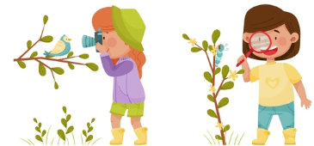
Forest School
The importance of Outdoor learning…​
Outdoor learning/play is a critical component of good provision and must be encouraged. It is essential for the healthy development of all young children.​
​
Boots –Walking boots or Wellington boots. Plastic wellies and several pairs of socks are a good idea if the weather is cold.​
Long trousers ​
Long sleeved top​
Layers of clothing appropriate to the temperature and the season ​
Hat (for sun or warmth depending on the season) and waterproof gloves.​
These should be old clothes or clothes that parents/guardians do not mind getting dirty. They will get dirty.​
Waterproofs: A waterproof coat and trousers would be brilliant, we do have some spares if forgotten or if you don’t have any.​

Slide 8

Continuous provision in Year 1
At Haddenham St Mary’s, we have taken a new approach to continuous provision. This year, in EYFS and Year 1we use a continuous provision model to facilitate learning across the curriculum.
Continuous provision refers to the resources which are always available within the classroom for the children to access to continue their learning independently. The continuous provision within the setting remains consistent for long periods of time.
Our environments allow for carefully planned and child led play-based experiences which encourage children to consolidate their skills, knowledge and understanding. This approach enables them to be independent, resilient learners who motivate themselves and not be afraid to take on new challenges.

Slide 9

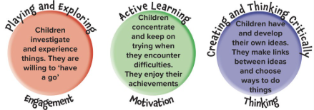
We passionately believe that children learn best through play and exploration. This is why in year 1, we have built on the excellent practice found in EYFS and have adopted a play based approach to learning. Continuous provision encourages curiosity and promotes challenge in learning, allowing children to explore their own interests independently. It enables children to make choices and initiate play without interaction with an adult.
We recognise that not all subjects can be taught through continuous provision. Some subjects need discrete teaching – these include: phonics, handwriting, English skills, Maths and foundation subject teaching inputs. All these subjects, however, can be enhanced and skills can be rehearsed within continuous provision to ensure children know more and remember more. Our environment, throughout year 1 also promotes the characteristics of effective learning.

Slide 10


Slide Tite
sunshine1@haddenham-st-marys.bucks.sch.uk
sunshine2@haddenham-st-marys.bucks.sch.uk

