Slide 1

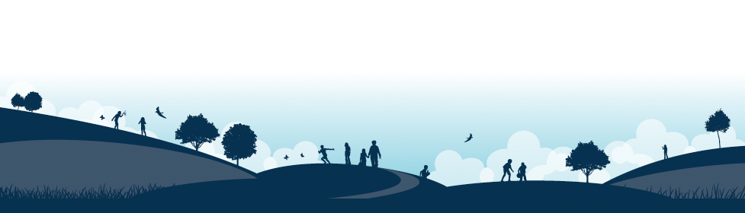
New Starters Information
We will sparkle like jewels under the guidance of Jesus, his word being a lamp unto our feet and a light unto our path.
Tuesday 16th June 2026

Slide 2
Welcome to Haddenham St Mary’s!
Our vision statement:
‘Excellence, care and fun and for all where every child can sparkle like a jewel’
Our legacy:
For every child and every family to take away wonderful memories of their early years with us.

Slide 3
Today’s Meeting:
To help your child make the best possible start to school.
To show you the curriculum that your child will be covering in the reception class.
To understand how we teach in order to cover the requirements of the curriculum.
To identify the key ways in which you can help your child at home and in school.
Housekeeping information.

Slide 4
Play is at the heart of what we do

Slide 5



EYFS – Rainbows Teachers
Rainbow 1: Mr Williams (EYFS Coordinator)
Rainbow 2: Mrs Butler Mrs Williams

Slide 6
EYFS
The Early Years Foundation Stage (EYFS) is the stage of education for children from birth to the end of the Reception year.
Reception is the final year of the EYFS.
It is based on the recognition that children learn best through play and active learning.

Slide 7
EYFS Curriculum
July 2025 EYFS Framework
Twinkl Phonics
Master the Curriculum- White Rose Maths
Helicopter Stories- communication, language and writing
Poetry Basket
Drawing Club
Funky fingers
NFER Baseline Assessment
Tapestry

Slide 8
A typical morning in Reception…
8.35 am Arrive, CP activities
8:50 am Register
8.55 am Phonics & literacy
9.15 am Snack
9.30 am CP activities
10.30 am Collective Worship
10.45 am School break
11.00 am Maths
11.15 am CP activities
11.50 am Get ready for lunch/ story
12.00 am Lunch & Break

Slide 9
A typical afternoon in Reception…
1.10pm Register
1.20pm Funky Fingers
1.40pm CP activities linked to a class input
2.30pm Tidy Up
2.40pm Story
3.10pm Home Time
EAD/UW/PSED class inputs during the week

Slide 10
Core Values
Respect
Honesty
Forgiveness
Love
Compassion
Friendship

Slide 11
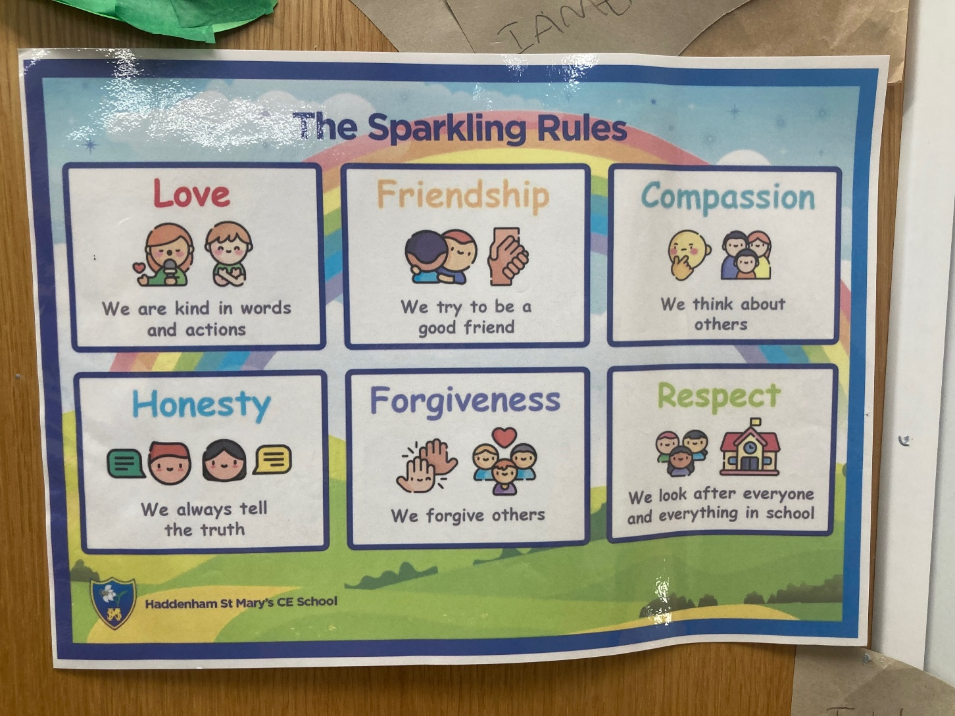
Sparkling Rules

Slide 12
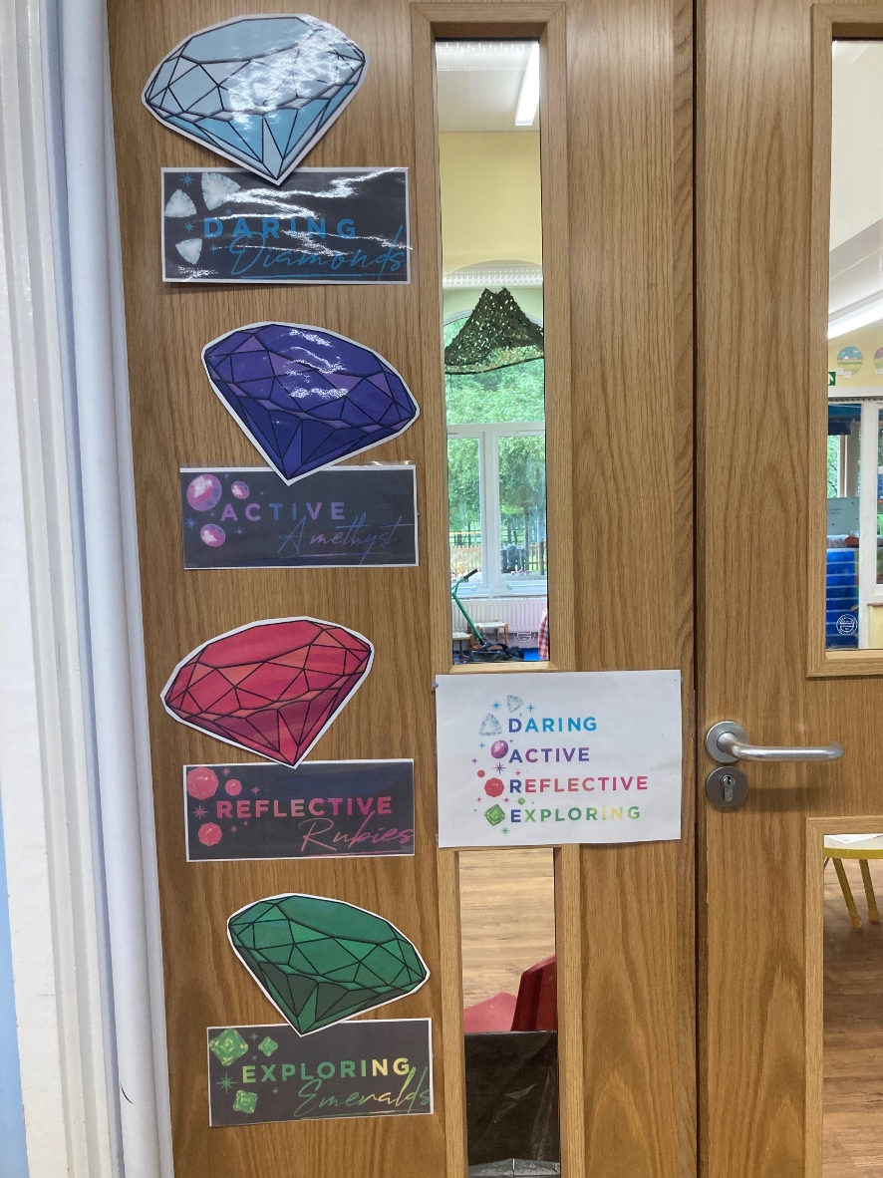
Learning Behaviours
‘You walked among the jewels that sparkled like fire.’ (Ezekiel 28:12-14)
Daring diamond
Active Amethyst
Reflective Ruby
Exploring Emerald

Slide 13
Zones of Regulation

Slide 14
Transition Arrangements
Tuesday 16th June: Stay and Play
May/June/July: Pre-school visits/calls
Tuesday 7th July: Class Transition Morning
Thursday 3rd – Wednesday 9th Part time sessions
September (morning or afternoons)
Thursday 10th September Full time 8.35am- 3.10pm

Slide 15
What to bring to school
Coat
Wellies- a pair to leave in school please
Book bag- we will provide this during their first full week
Change of clothes in drawstring bag if possible (to remain in school)
Sunhat when appropriate
Snack (small tub with 5 snacks for the week please, no nuts)
Medication which needs to be in school (Please collect medical forms from the office)
Everything named- preferably with iron on labels, sharpie pen or stamped

Slide 16
How you can help your child prepare
Coats
Toilet
Counting
Read lots of stories and poems
Knife and fork
Happy and swift goodbyes
Enjoy your summer together
Speak to us about any anxieties

Slide 17
Medical Matters
Any sickness, diarrhoea, must be followed by 48 hours absence please.
Please phone the school office to report absence by 8:30am if possible.
Please inform us of any existing medical conditions/allergies.
Any medicines can only be administered if prescribed and by prior arrangement please.

Slide 18
Information Packs
Contact Information
Tapestry
Home/School Agreements
Permissions, photos etc
Proof of birth

